Slide 1
Tableau Visualization On Coffee Chain Database By Archit Jajoo

Slide 2
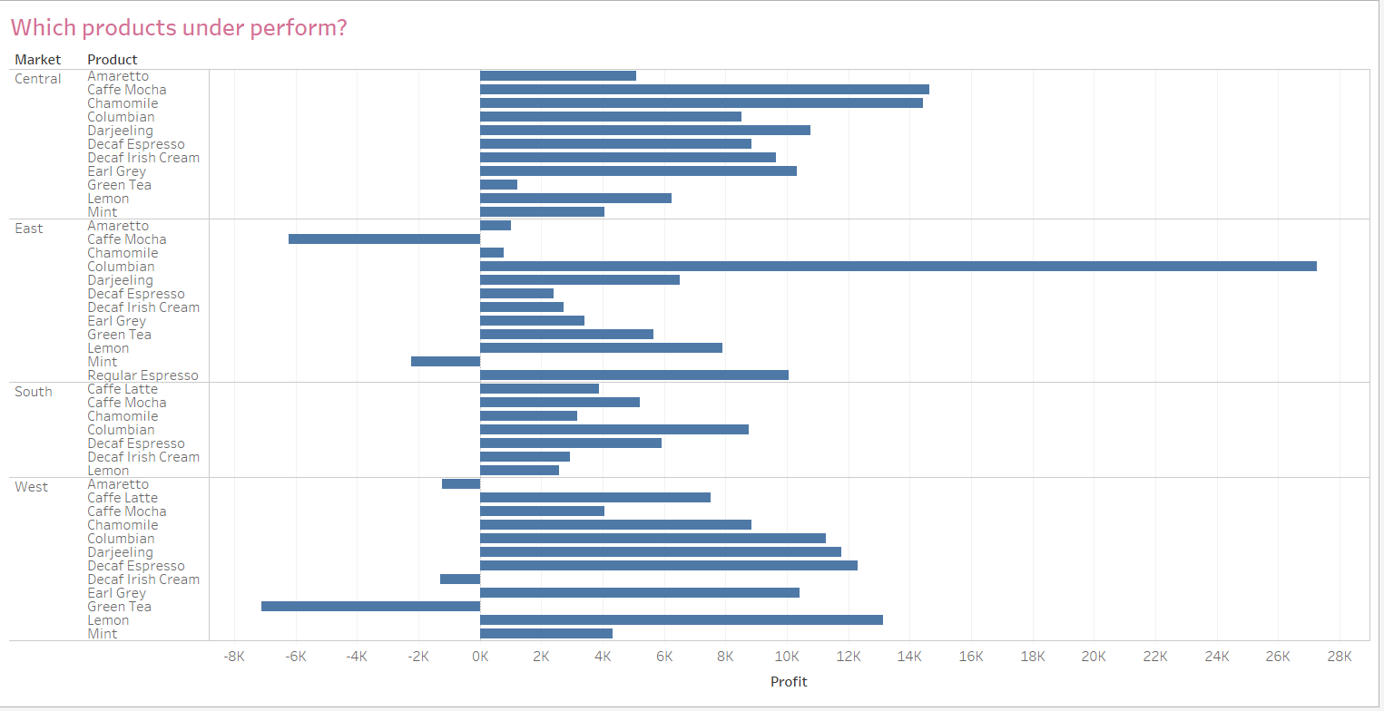
Underperforming Products

Slide 3
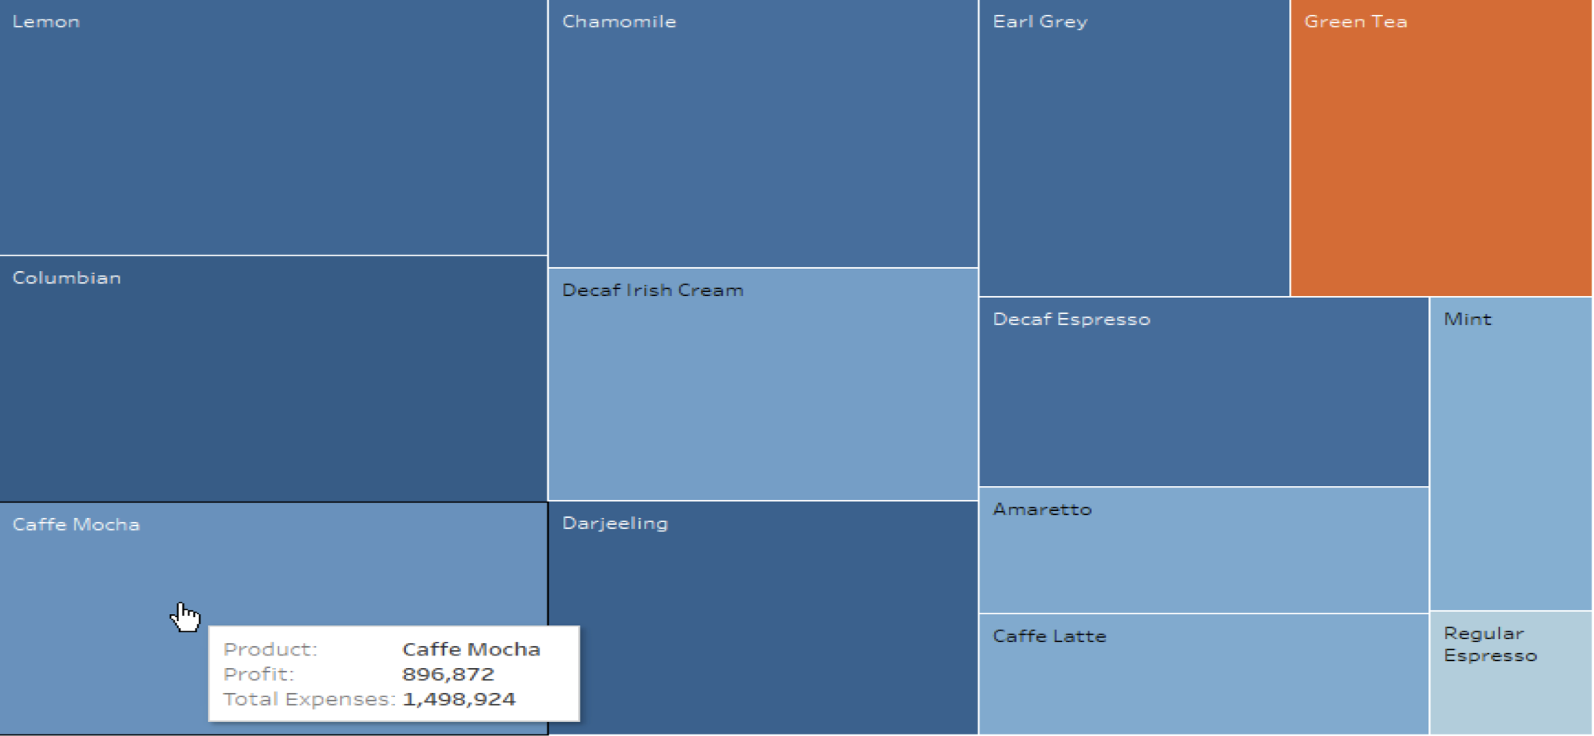
ROI By Product

Slide 4
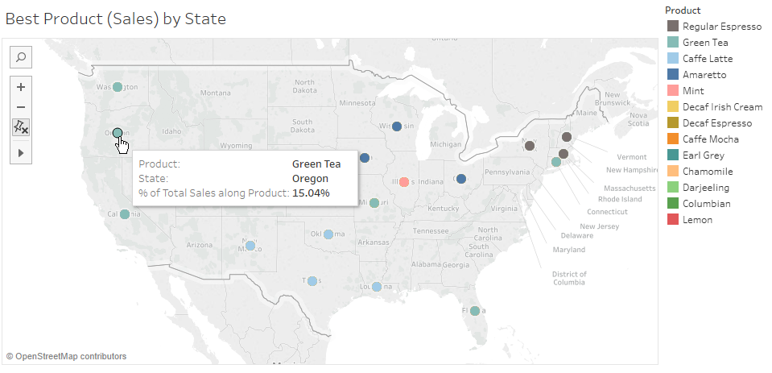
Best Product By State

Slide 5
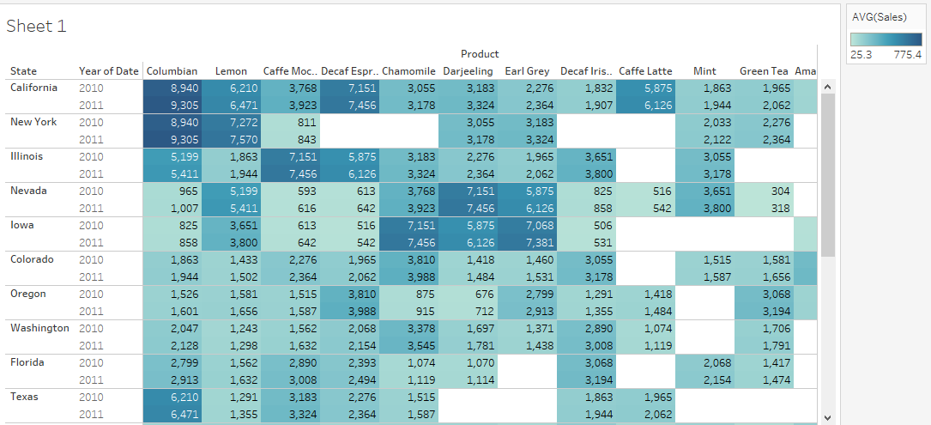
Product Sales Vs. State

Slide 6
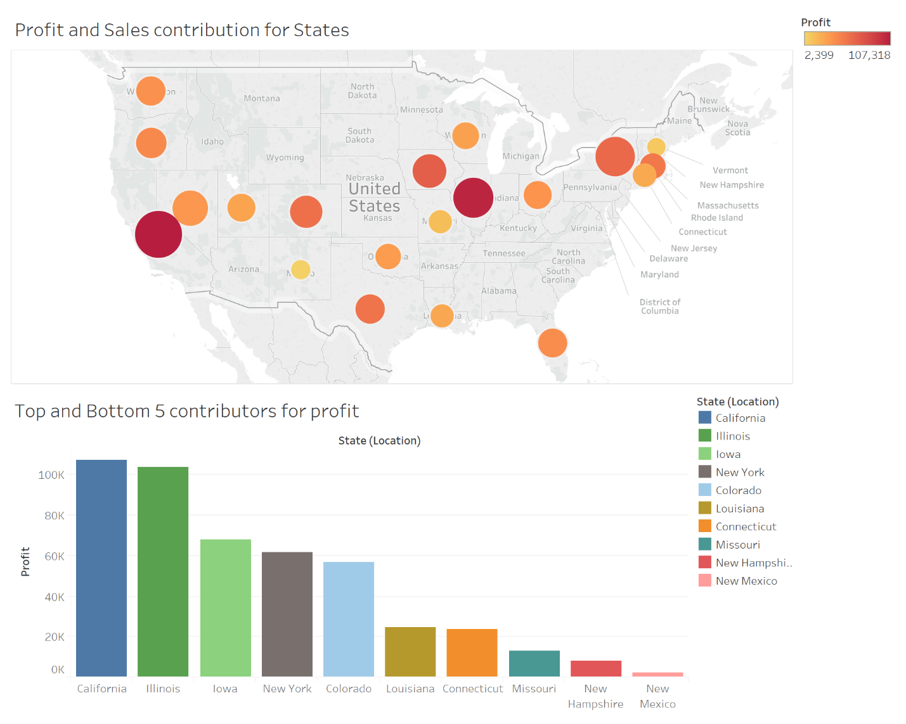
Sales And Profit Contribution Of State

Slide 7
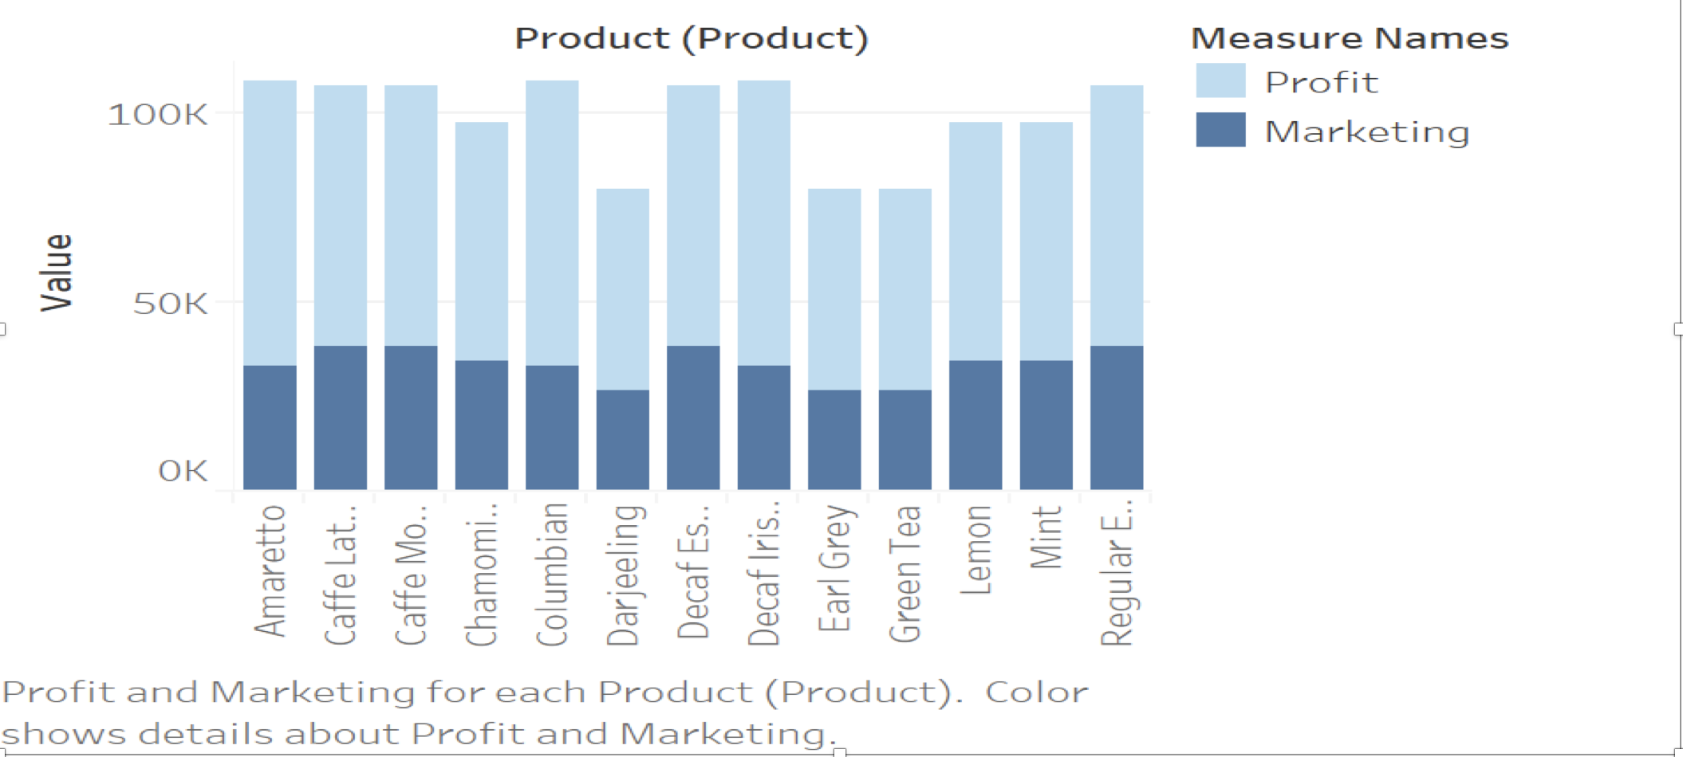
Marketing ROI By Product

Slide 8
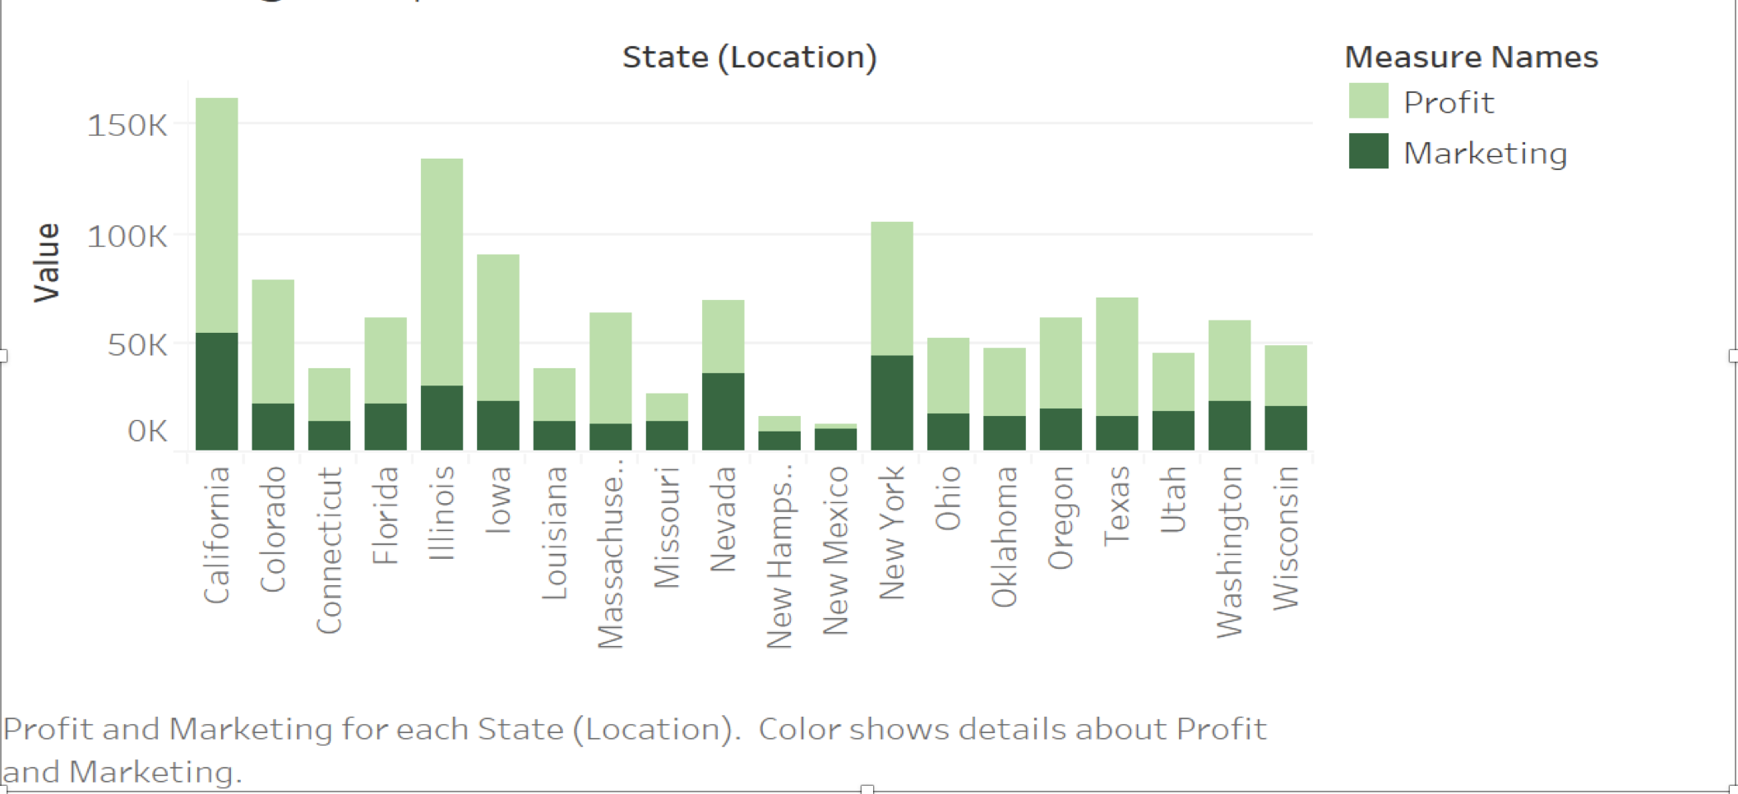
Marketing ROI By State

Slide 9
Thank You

